Slide 1
An Introduction to Explainable Artificial Intelligence
Dr. Joseph (Yossi) Cohen
Schmidt AI in Science Postdoctoral Research Fellow, MIDAS
AI in Science and Engineering Summer Academy 2023
August 11, 2023

Slide 2

Instructor Background
Schmidt AI in Science Fellow – MIDAS
Mentors: Prof. Xun Huan (ME) & Prof. Eunshin Byon (IOE)
University of Michigan
PhD in Mechanical Engineering (2023)
Advisor: Prof. Jun Ni (S.M. Wu Manufacturing Research Center)
Thesis: “Augmented Intelligence for Fault Diagnosis in Advanced Manufacturing”
MSE in Mechanical Engineering (2021)
BSE in Mechanical Engineering (2018)
Research Interests:
Explainable artificial intelligence (XAI)
Prognostics and health management (PHM)
Advanced & sustainable manufacturing

Slide 3
Learning Goals
By the end of this module, you will gain:
Exposure and working knowledge on XAI techniques
Hands-on experience with implementing state-of-the-art XAI algorithms
Awareness on current XAI strengths and limitations
Guidance on responsible usage and interpretation

Slide 4
Module Agenda
Explainable AI (XAI) background and motivation
Inherently interpretable modeling
Linear regression
Decision trees
Anomaly detection and interpretation
Principal component analysis
One-class support vector machine
Counterfactual explanations
Model-agnostic explanations
LIME: Local Interpretable Model-Agnostic Explanations
SHAP: SHapley Additive exPlanations
Responsible usage of XAI

Slide 5
Module Agenda
Explainable AI (XAI) background and motivation
Inherently interpretable modeling
Linear regression
Decision trees
Anomaly detection and interpretation
Principal component analysis
One-class support vector machine
Counterfactual explanations
Model-agnostic explanations
LIME: Local Interpretable Model-Agnostic Explanations
SHAP: SHapley Additive exPlanations
Responsible usage of XAI

Slide 6
Perspectives: How Can I Trust AI Models When…
End User Perspective
They don’t justify their predictions
They are cumbersome to train & validate
Developmental Perspective
Regulatory Perspective
They do not comply with existing policy
They may contradict established science
Scientific Perspective
They don’t improve KPIs meaningfully enough to yield good ROI
Industrial Perspective

Slide 7

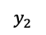
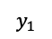
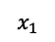
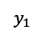
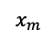
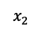
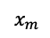
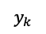
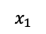
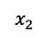
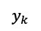
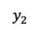
Background: Explainable AI (XAI)
Difficult to interpret nonlinear models
“Black magic” predictions
Feature importance & attribution
Lack of reliability ⬅➔ Lack of trust
Demand for AI systems to be interpretable for smooth adoption
Explainable AI: Enables us to “recognize, learn, understand, interpret, and articulate how an AI model or system concludes and makes decisions” (Ahmed et al., 2022)
$$x_{1}$$
$$y_{1}$$
“Black Box”
AI Model
$$x_{2}$$
$$y_{2}$$
$$x_{m}$$
$$y_{k}$$
$$x_{1}$$
$$y_{1}$$
“Glass Box”
XAI Model
$$x_{2}$$
$$y_{2}$$
$$x_{m}$$
$$y_{k}$$
I. Ahmed, G. Jeon, and F. Piccialli, From Artificial Intelligence to Explainable Artificial Intelligence in Industry 4.0: A Survey on What, How, and Where, IEEE Trans. on Industrial Informatics, vol. 18. no. 8, pp. 5031-5042. 2022.

Slide 8
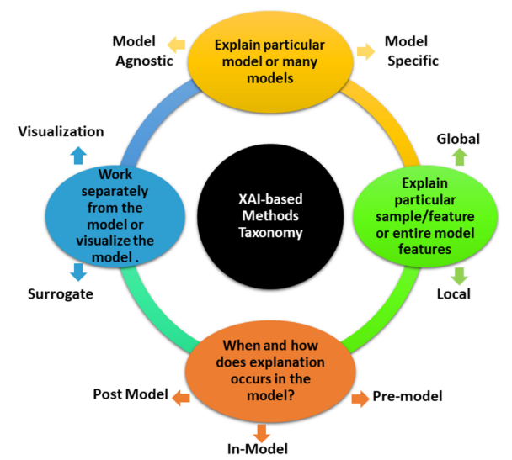
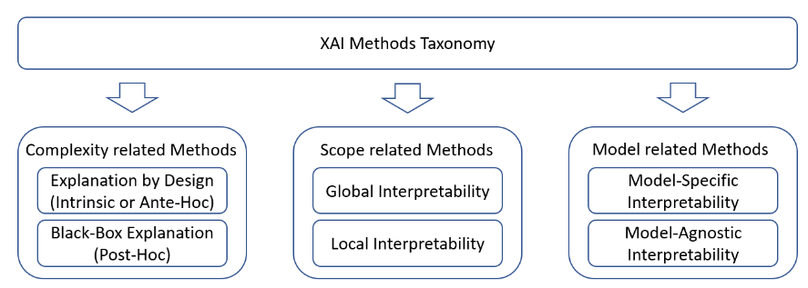
Taxonomy of XAI Approaches
(Sofianidis et al., 2021)
(Ahmed et al., 2022)

Slide 9
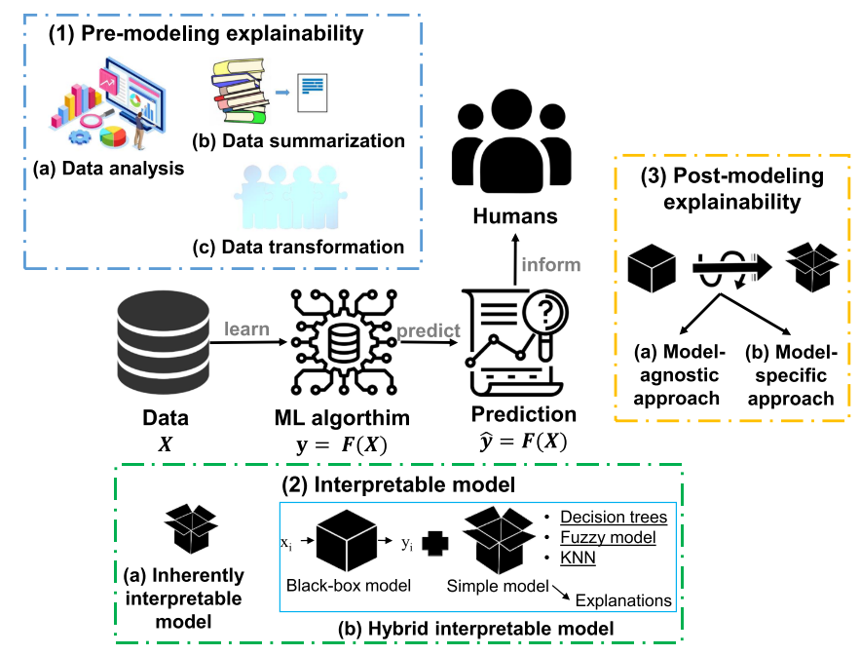
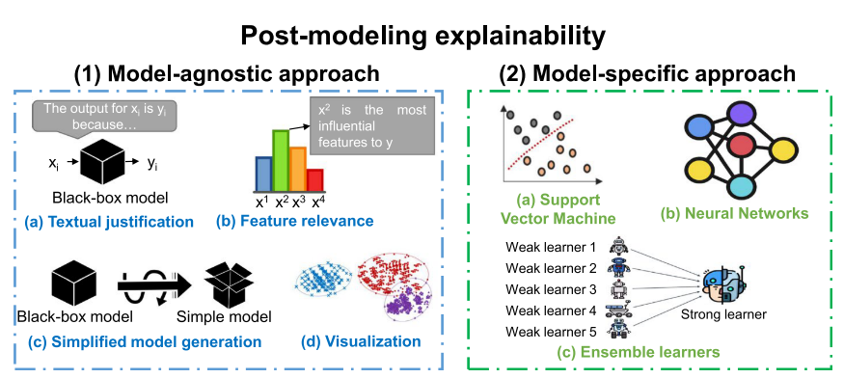
Taxonomy of XAI Approaches
(Minh et al., 2022)
(Minh et al., 2022)
D. Minh, H. X. Wang, Y. F. Li, and T. N. Nguyen, Explainable artificial intelligence: a comprehensive review, Artificial Intelligence Review, vol. 55, pp. 3503-3568. 2022.

Slide 10
Module Agenda
Explainable AI (XAI) background and motivation
Inherently interpretable modeling
Linear regression
Decision trees
Anomaly detection and interpretation
Principal component analysis
One-class support vector machine
Counterfactual explanations
Model-agnostic explanations
LIME: Local Interpretable Model-Agnostic Explanations
SHAP: SHapley Additive exPlanations
Responsible usage of XAI
Notes:
9:15

Slide 11
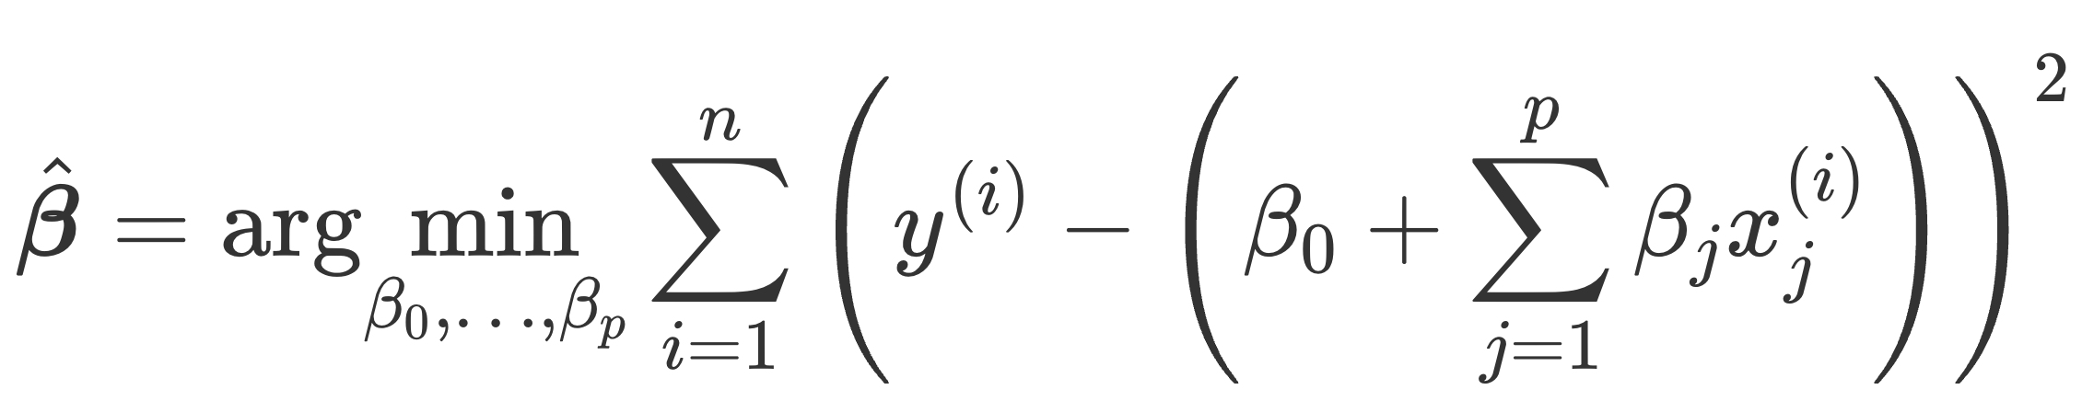
“Inherently Interpretable”: Linear Regression
Linear regression: simple, parametric, additive
OLS objective in finding optimal weights:
Intuitive, particularly for numerical features
Feature scaling significantly improves weight interpretation
Weights imply the contribution: foundational idea of XAI
Molnar, C. (2022), Interpretable Machine Learning:
A Guide for Making Black Box Models Explainable (2nd ed.).
christophm.github.io/interpretable-ml-book/

Slide 12
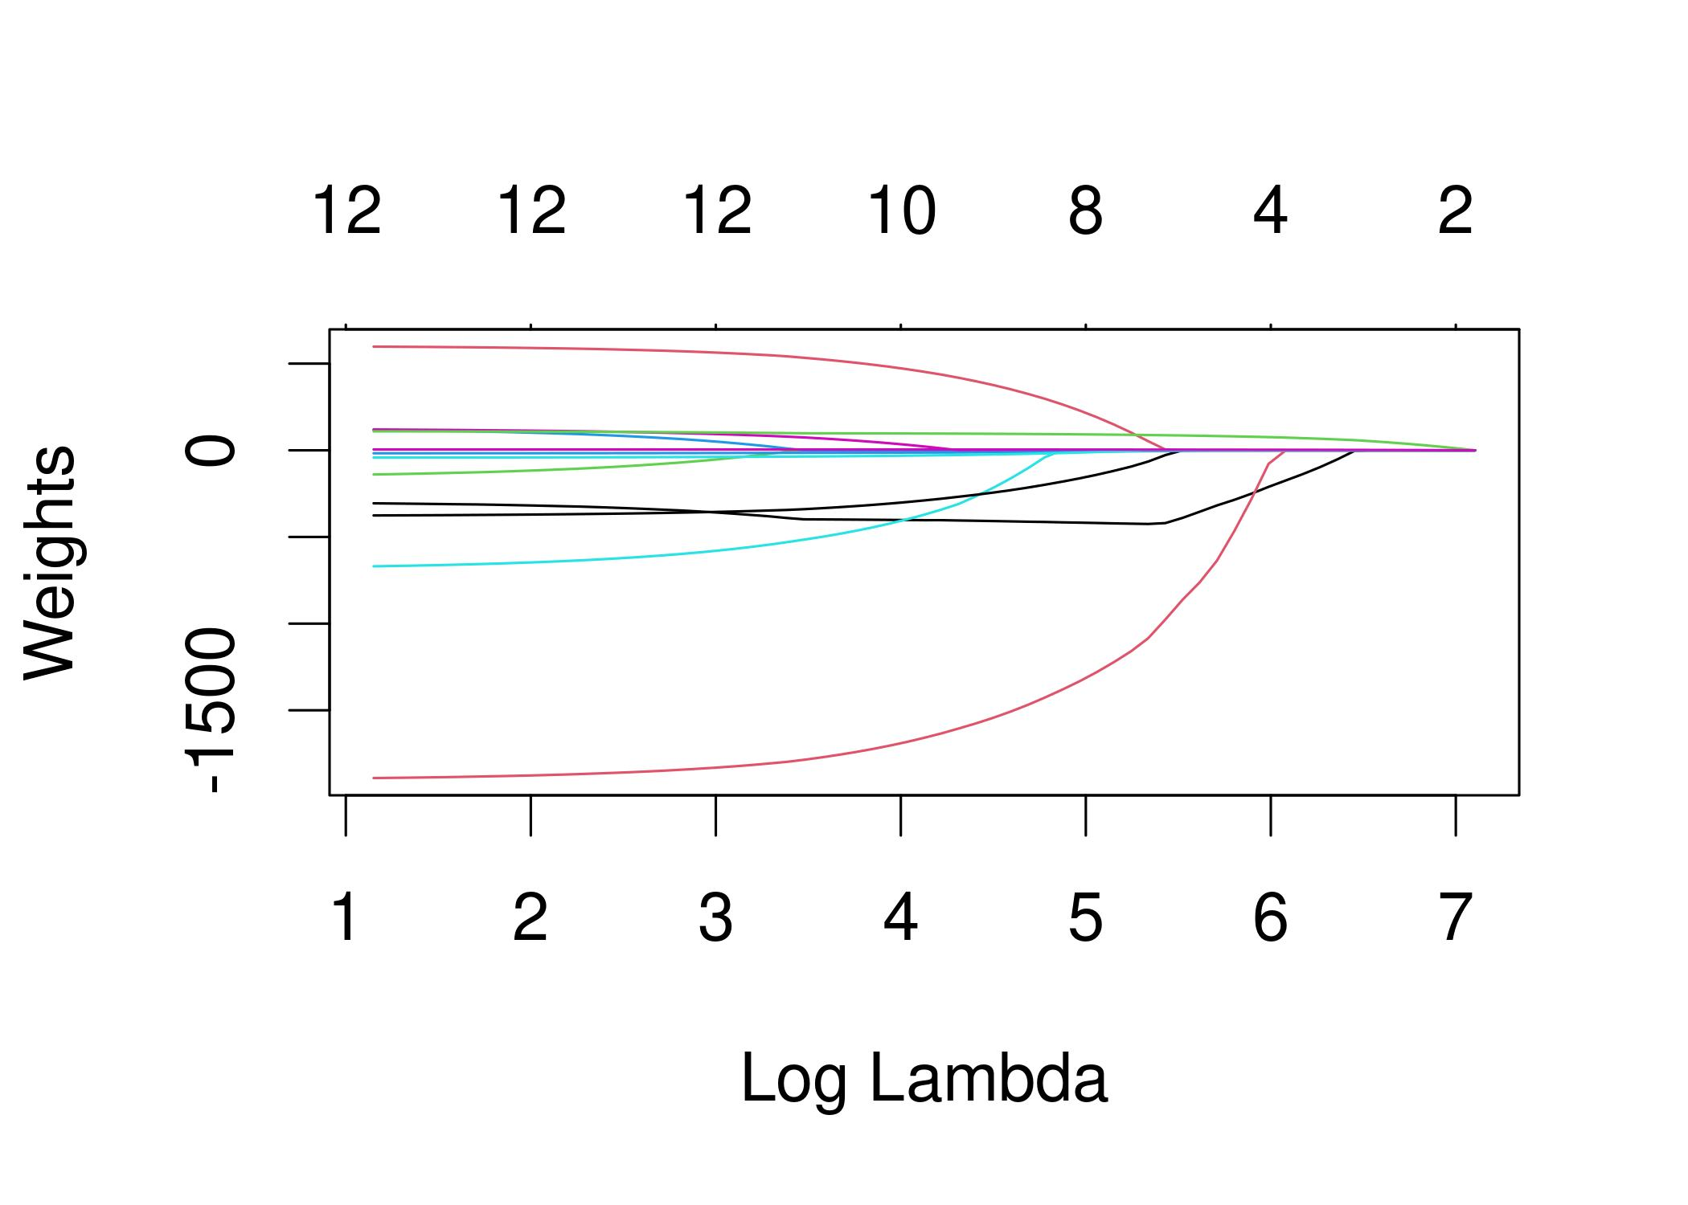
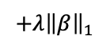
“Inherently Interpretable”: LASSO Regression
Interpretability suffers under curse of dimensionality
Solution: sparsify weights to “zero” out unimportant contributions
Least Absolute Shrinkage and Selection Operator (LASSO): Adds L1-norm constraint to penalize weight vector
$$+λ{\left\|β\right\|}_{1}$$
# Non-Zero Weights
Molnar, C. (2022), Interpretable Machine Learning:
A Guide for Making Black Box Models Explainable (2nd ed.).
christophm.github.io/interpretable-ml-book/

Slide 13
Linear Regression: Pros and Cons
Advantages
Disadvantages
Simple and relatively generalizable (small datasets)
Easy to form explanations with scaled features
Regularization can improve model performance and interpretation
Analog for classification (logistic regression)
Lacks expressiveness of nonlinear models
Struggle under high dimensionality
Feature interactions must be manually engineered
Direct interpretation depends on feature encoding and scaling

Slide 14
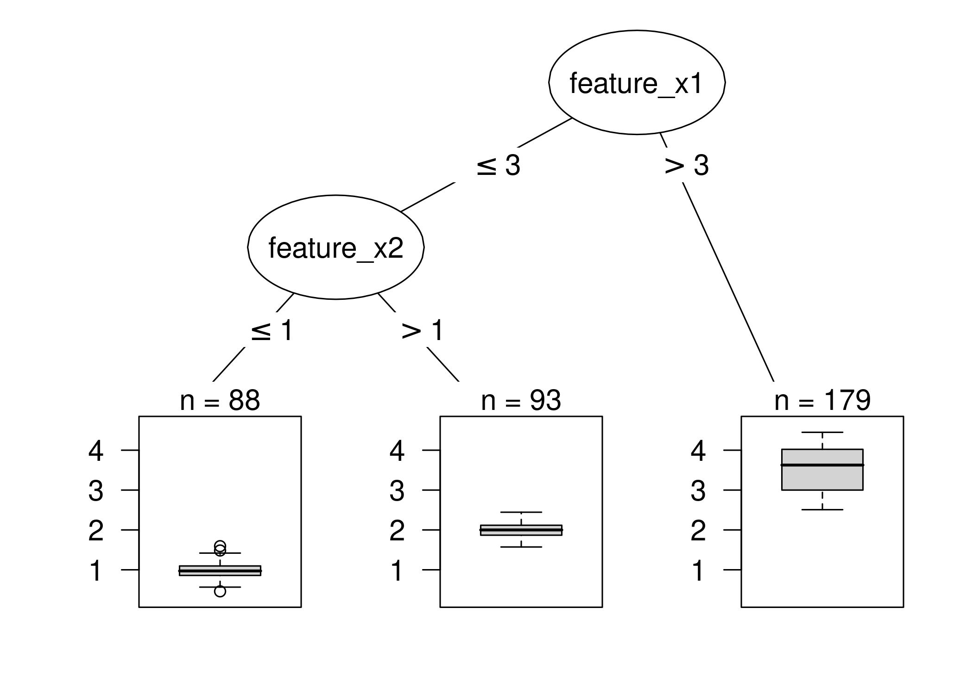
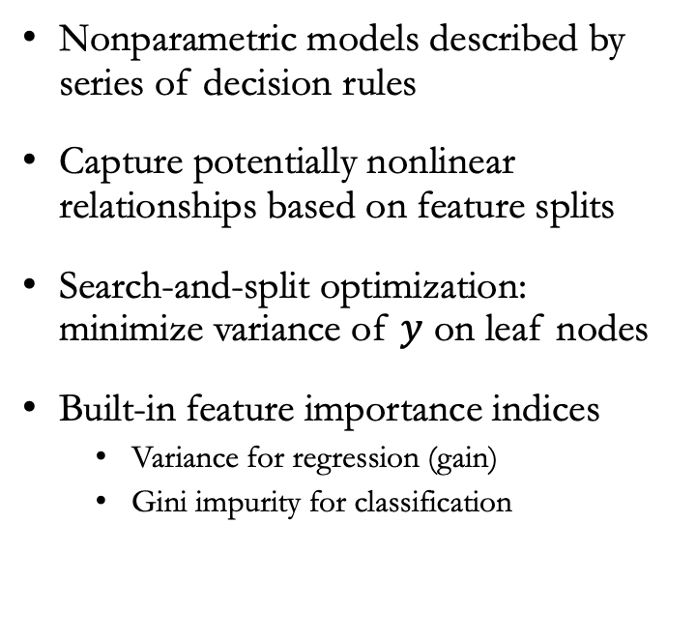
“Inherently Interpretable”: Decision Trees
Nonparametric models described by series of decision rules
Capture potentially nonlinear relationships based on feature splits
Search-and-split optimization: minimize variance of $y$ on leaf nodes
Built-in feature importance indices
Variance for regression (gain)
Gini impurity for classification
Molnar, C. (2022), Interpretable Machine Learning:
A Guide for Making Black Box Models Explainable (2nd ed.).
christophm.github.io/interpretable-ml-book/

Slide 15
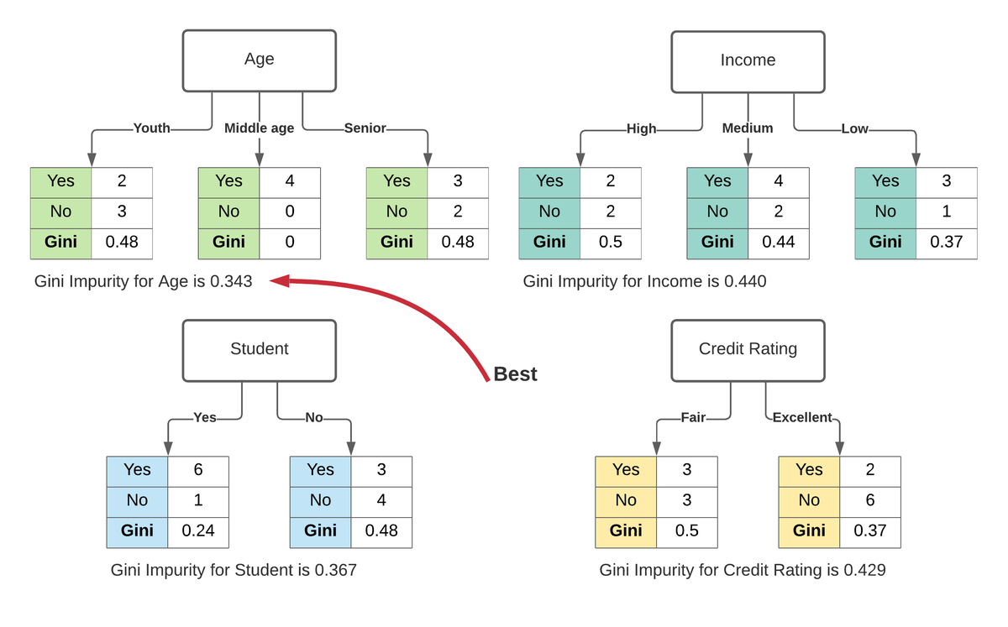
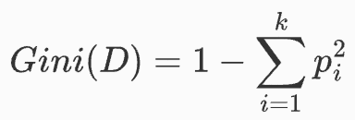
“Inherently Interpretable”: Decision Trees
(Karabiber 2023)
$p_{i}:$probability (based on count) of belonging to $i^{th}$ of $k$ classes

Slide 16
Decision Trees: Pros and Cons
Advantages
Disadvantages
Intuitive for explaining feature relationships
Compatible with features in original scales
Regularization and tree pruning can prevent overfitting
Built-in feature importance indices
Often brittle and unstable behavior
Deep trees are less generalizable and interpretable
Nonparametric nature can lead to lack of smoothness

Slide 17
Module Agenda
Explainable AI (XAI) background and motivation
Inherently interpretable modeling
Linear regression
Decision trees
Anomaly detection and interpretation
Principal component analysis for anomaly scoring
One-class support vector machine
Counterfactual explanations
Model-agnostic explanations
LIME: Local Interpretable Model-Agnostic Explanations
SHAP: SHapley Additive exPlanations
Responsible usage of XAI
Notes:
9:25

Slide 18
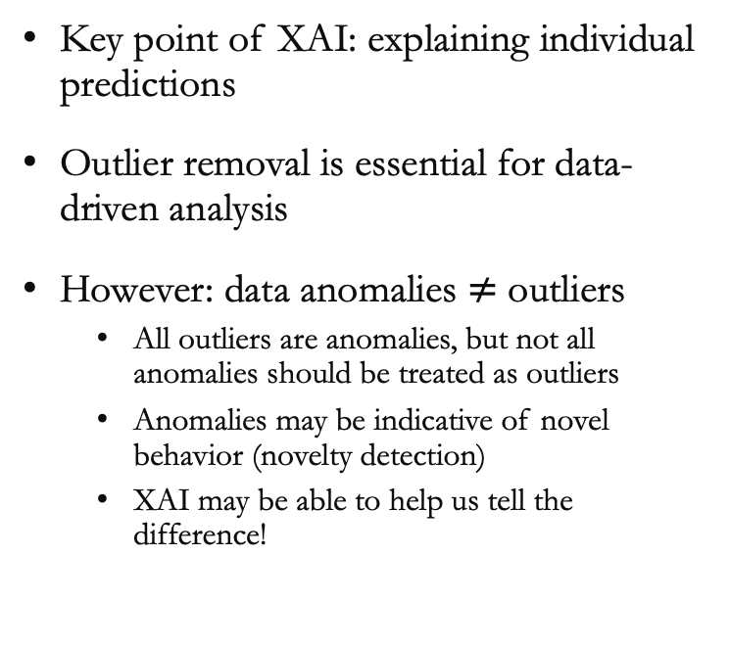
Why is Anomaly Detection Important for XAI?
Key point of XAI: explaining individual predictions
Outlier removal is essential for data-driven analysis
However: data anomalies $≠$ outliers
All outliers are anomalies, but not all anomalies should be treated as outliers
Anomalies may be indicative of novel behavior (novelty detection)
XAI may be able to help us tell the difference!
Unsupervised
Amount of Labeled Data
Semi-Supervised
Fully Supervised

Slide 19
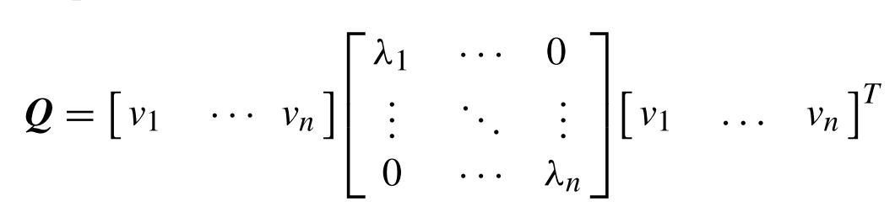

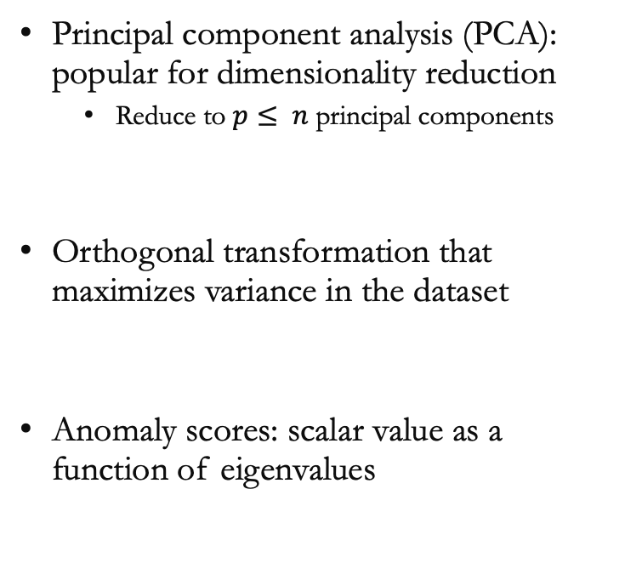
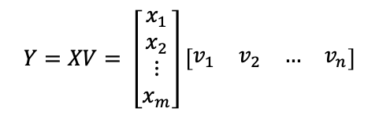

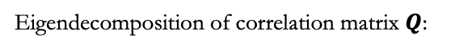
PCA-based Anomaly Scoring
(Full PCA)
Principal component analysis (PCA): popular for dimensionality reduction
Reduce to $p≤ n$ principal components
Orthogonal transformation that maximizes variance in the dataset
Anomaly scores: scalar value as a function of eigenvalues
Eigendecomposition of correlation matrix $Q$:
$n$ eigenvalues for $n$ total features
Linear transformation with new PC basis:
$$Y=XV= \left[\begin{matrix}x_{1} \\ x_{2} \\ ⋮ \\ x_{m}\end{matrix}\right]\left[\begin{matrix}v_{1} & v_{2} & … & v_{n}\end{matrix}\right]$$
Standardized data matrix $(m × n)$
M. L. Shyu et al., A Novel Anomaly Detection Scheme Based on Principal Component Classifier, Proceedings of ICDM’03, 2003.

Slide 20
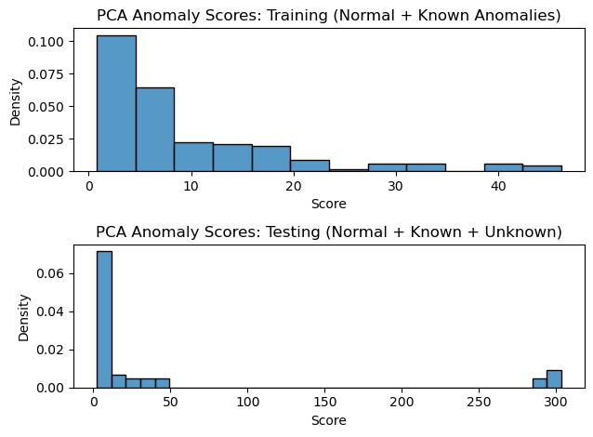
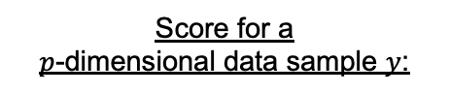
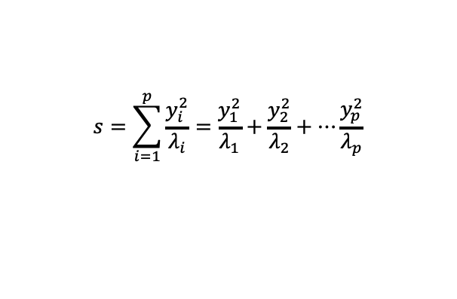
PCA-based Anomaly Scoring
Recent application for PHM AP 2023 Data Challenge
Score for a
$p$-dimensional data sample $y$:
$$s=\sum_{i=1}^{p}{\frac{y_{i}^{2}}{λ_{i}}}=\frac{y_{1}^{2}}{λ_{1}}+\frac{y_{2}^{2}}{λ_{2}}+…\frac{y_{p}^{2}}{λ_{p}}$$
(Semi)-Supervised Application:
Learn PCA model on a training set with known or nominal behavior
Apply transformation and anomaly scoring to unknown distribution

Slide 21
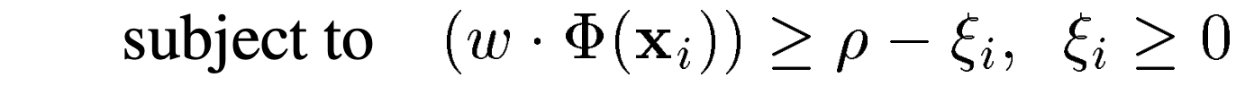
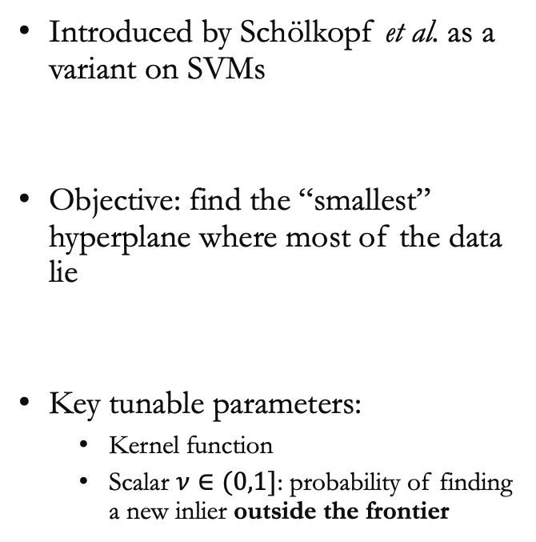
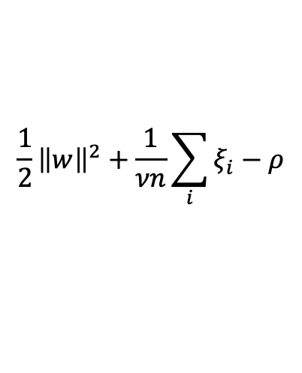
One-Class Support Vector Machines (OCSVMs)
Introduced by Schölkopf et al. as a variant on SVMs
Objective: find the “smallest” hyperplane where most of the data lie
Key tunable parameters:
Kernel function
Scalar $ν∈(0,1]$: probability of finding a new inlier outside the frontier
Define frontier of hyperplane
$$\frac{1}{2}{\left\|w\right\|}^{2}+\frac{1}{νn}\sum_{i}{ξ_{i}−ρ}$$
min
Slack variables
Bernhard Schölkopf et al., Support Vector Method for Novelty Detection, NIPS'99: Proceedings of the 12th International Conference on Neural Information Processing Systems, pp. 582-588. 1999.

Slide 22
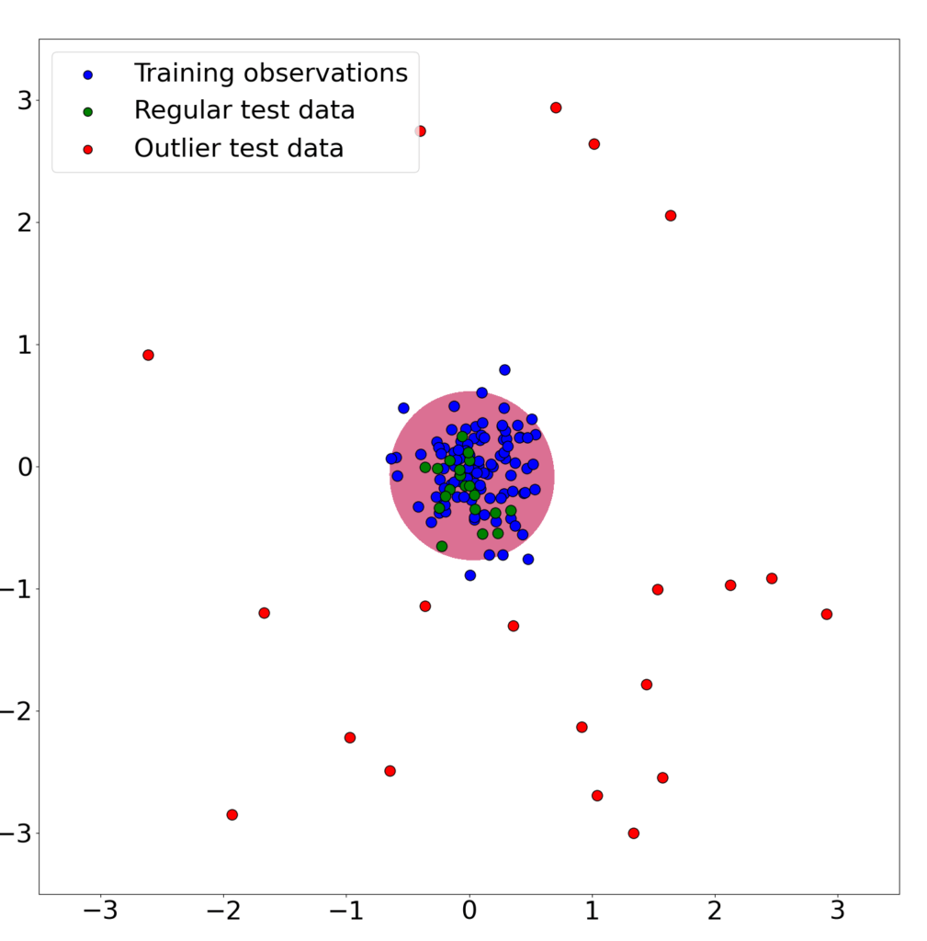
One-Class Support Vector Machines (OCSVMs)
+1: Inliers
-1: Outliers
Baeldung

Slide 23
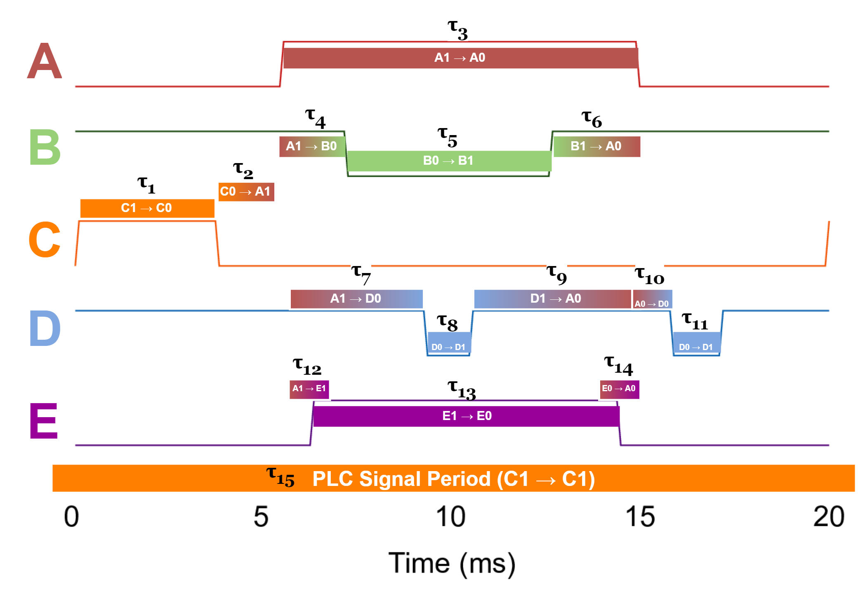
Research Example: Anomaly Detection on Time Delays
J. Cohen, B. Jiang, and J. Ni. EveSyncIAI: Event Synchronization Industrial Augmented Intelligence for Fault Diagnosis, IEEE Transactions on Semiconductor Manufacturing, vol. 35(3) pp. 446-456. 2022.

Slide 24
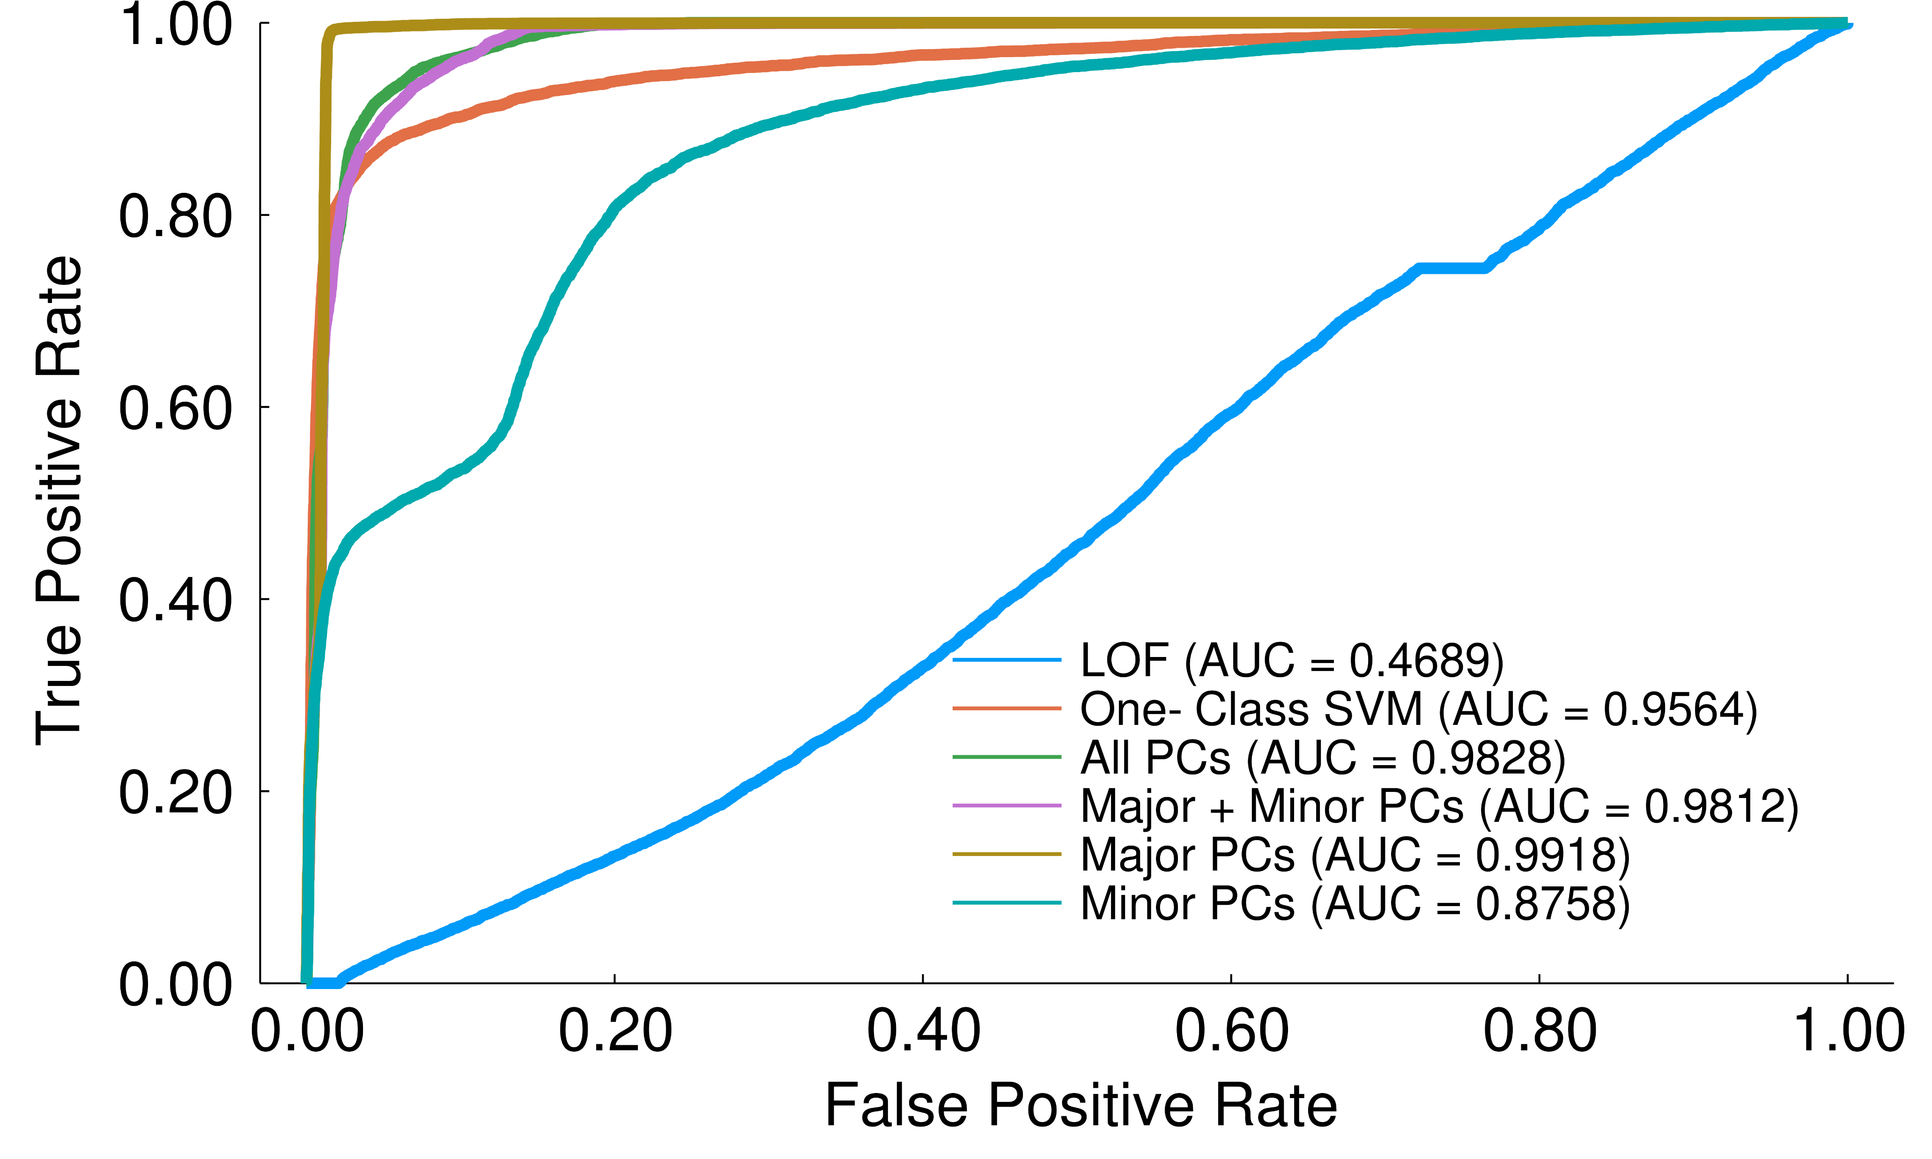
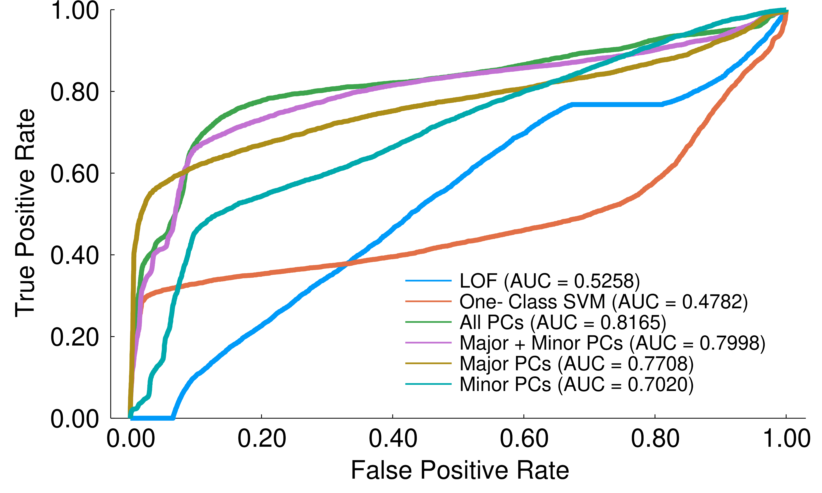
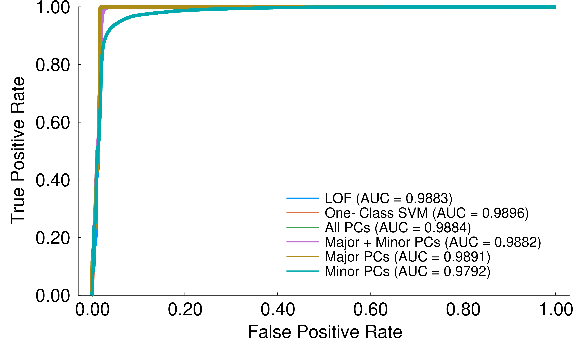
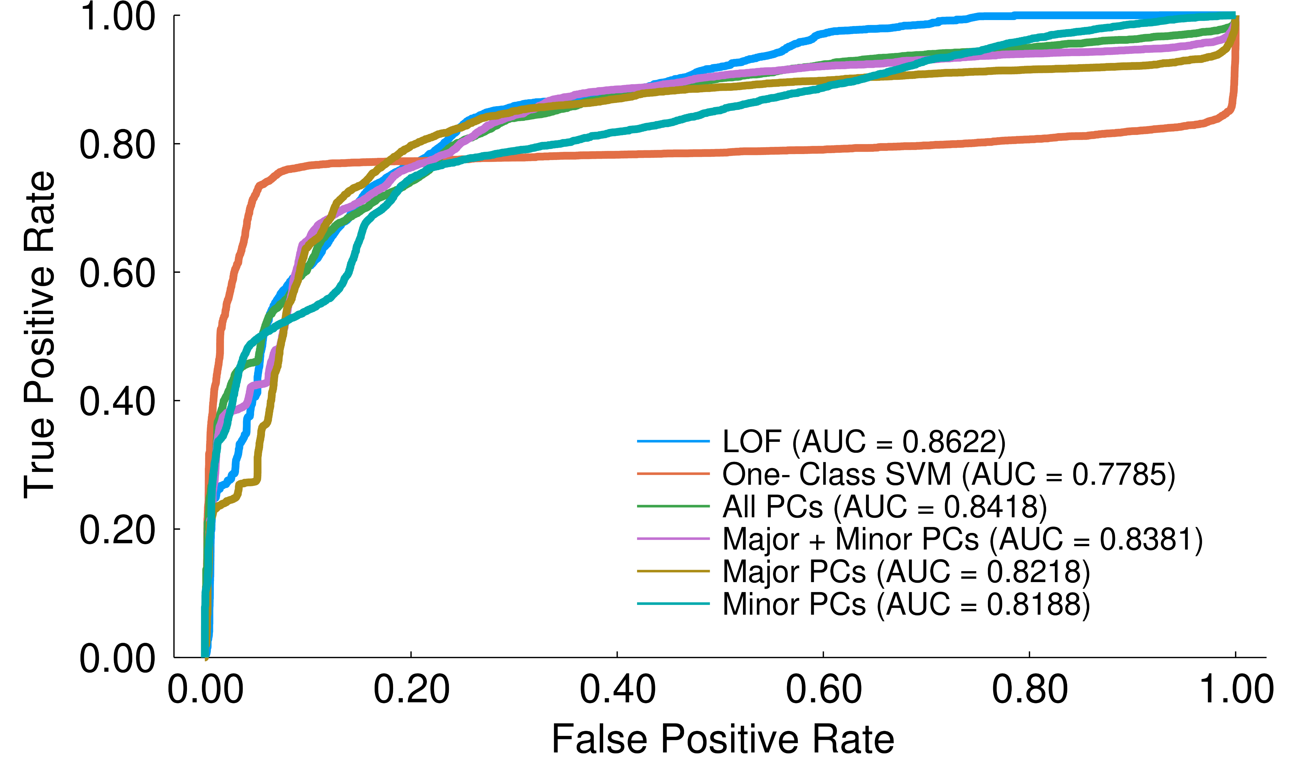
Research Example: Anomaly Detection on Time Delays
Unsupervised Anomaly Detection
EveSyncIAI Features
PCA Features
Semi-Supervised* Anomaly Detection
EveSyncIAI Features
PCA Features
*1% of the dataset used for training
J. Cohen, B. Jiang, and J. Ni. EveSyncIAI: Event Synchronization Industrial Augmented Intelligence for Fault Diagnosis, IEEE Transactions on Semiconductor Manufacturing, vol. 35(3) pp. 446-456. 2022.

Slide 25
Anomaly Detection Algorithms: Pros and Cons
Advantages
Disadvantages
Can work with weakly labeled data scenarios
Interpretation: anomalous samples deviate from dataset distribution
Effective for global anomaly detection
Fast anomaly scoring possible for real-time applications
Conventionally limited to single class classification
Unclear which original features contribute to anomaly determination
Require additional analysis for local interpretability

Slide 26
Module Agenda
Explainable AI (XAI) background and motivation
Inherently interpretable modeling
Linear regression
Decision trees
Anomaly detection and interpretation
Principal component analysis
One-class support vector machine
Counterfactual explanations
Model-agnostic explanations
LIME: Local Interpretable Model-Agnostic Explanations
SHAP: SHapley Additive exPlanations
Responsible usage of XAI
Notes:
9:40

Slide 27
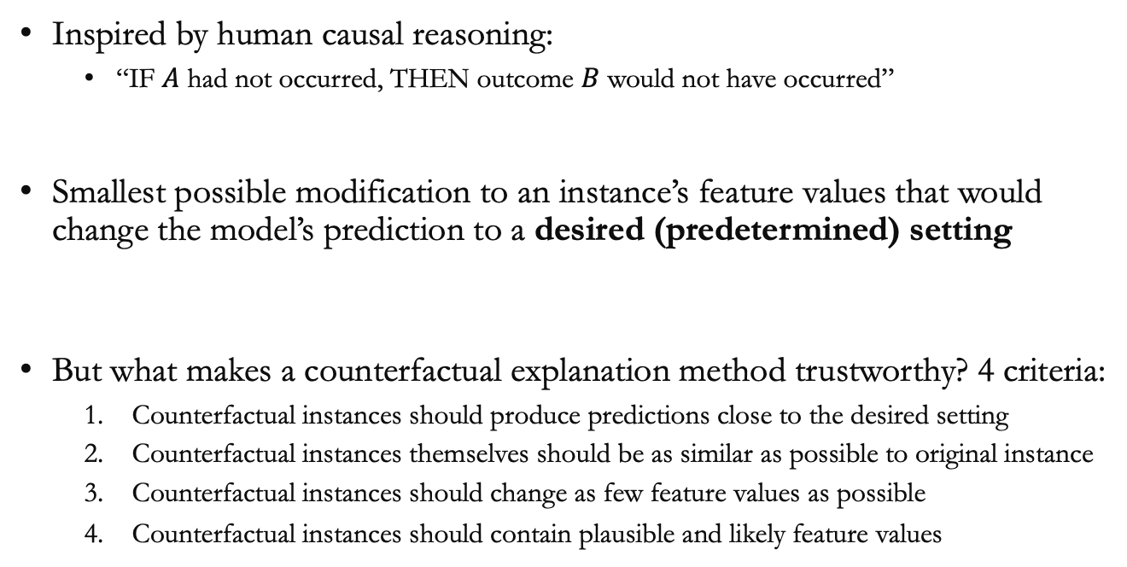
Counterfactual Explanations
Inspired by human causal reasoning:
“IF $A$ had not occurred, THEN outcome $B$ would not have occurred”
Smallest possible modification to an instance’s feature values that would change the model’s prediction to a desired (predetermined) setting
But what makes a counterfactual explanation method trustworthy? 4 criteria:
Counterfactual instances should produce predictions close to the desired setting
Counterfactual instances themselves should be as similar as possible to original instance
Counterfactual instances should change as few feature values as possible
Counterfactual instances should contain plausible and likely feature values
Molnar, C. (2022), Interpretable Machine Learning:
A Guide for Making Black Box Models Explainable (2nd ed.).
christophm.github.io/interpretable-ml-book/

Slide 28
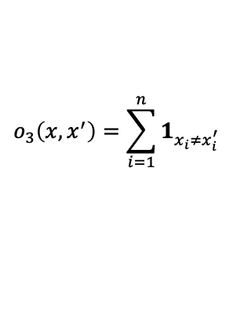
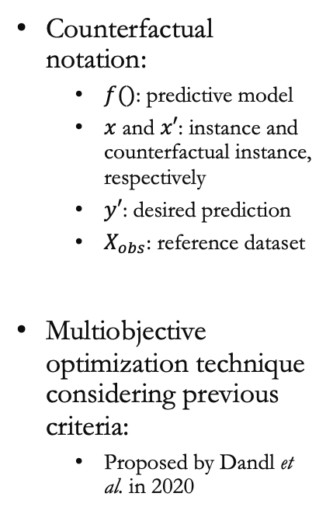
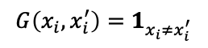
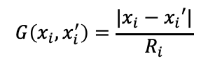
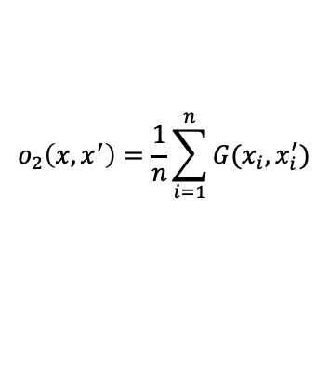
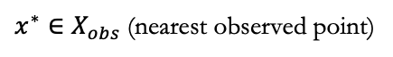
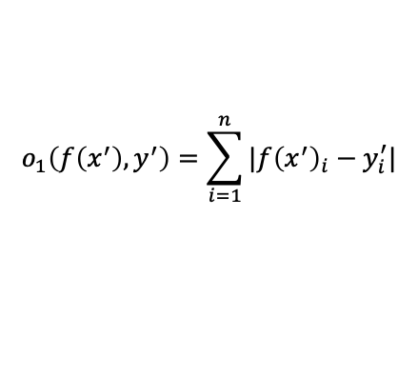
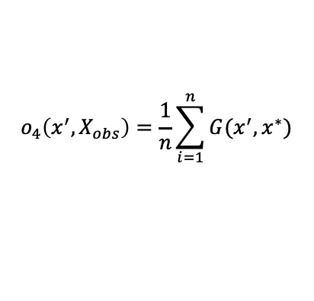
Counterfactual Explanations: Multiobjective Optimization
Counterfactual notation:
$f()$: predictive model
$x$ and $x′$: instance and counterfactual instance, respectively
$y′$: desired prediction
$X_{obs}$: reference dataset
Multiobjective optimization technique considering previous criteria:
Proposed by Dandl et al. in 2020
1) Proximity to desired prediction setting
2) Proximity to original instance
$$o_{1}\left(f\left(x^{′}\right), y^{′}\right)=\sum_{i=1}^{n}{|f{\left(x^{′}\right)}_{i}−y_{i}^{′}|}$$
$$o_{2}\left(x, x^{′}\right)=\frac{1}{n}\sum_{i=1}^{n}{G(x_{i}, x_{i}^{′})}$$
Numerical
Categorical
$$G\left(x_{i}, x_{i}^{′}\right)=\frac{|x_{i}−x_{i}′|}{R_{i}}$$
$$G\left(x_{i}, x_{i}^{′}\right)=1_{x_{i}≠x_{i}^{′}}$$
(observed feature range)
3) Sparse feature modifications
4) Proximity to nearest plausible point
$$o_{3}\left(x, x^{′}\right)=\sum_{i=1}^{n}{1_{x_{i}≠x_{i}^{′}}}$$
$$o_{4}\left(x^{′},X_{obs}\right)=\frac{1}{n}\sum_{i=1}^{n}{G(x^{′},x^{∗})}$$
$x^{∗}∈X_{obs}$(nearest observed point)
Molnar, C. (2022), Interpretable Machine Learning:
A Guide for Making Black Box Models Explainable (2nd ed.).
christophm.github.io/interpretable-ml-book/

Slide 29
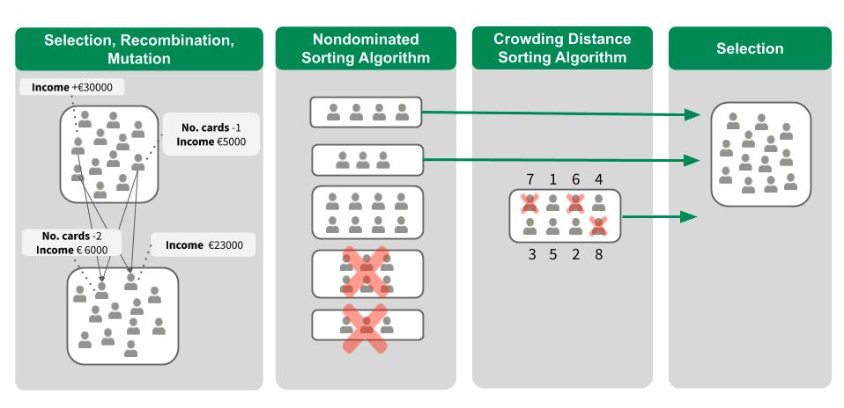

Counterfactual Explanations: Multiobjective Optimization
Find $x^{′}$candidates that minimize the multiobjective optimization problem:
$${L\left(f, x, x^{′}, y^{′}, X_{obs}\right)=(o}_{1}\left(f\left(x^{′}\right), y^{′}\right), o_{2}\left(x, x^{′}\right), o_{3}\left(x, x^{′}\right), o_{4}(x^{′}, X_{obs}))$$
Nondominated Sorting Genetic Algorithm
Molnar, C. (2022), Interpretable Machine Learning:
A Guide for Making Black Box Models Explainable (2nd ed.).
christophm.github.io/interpretable-ml-book/

Slide 30

Counterfactual Explanations: Example
Credit risk score application: what would improve this customer’s credit risk?
How to increase this probability to 50%?
Current probability of “good” credit risk (based on SVM model): 24.2%
Molnar, C. (2022), Interpretable Machine Learning:
A Guide for Making Black Box Models Explainable (2nd ed.).
christophm.github.io/interpretable-ml-book/

Slide 31

Counterfactual Explanations: Example
Top 10 Counterfactuals
Molnar, C. (2022), Interpretable Machine Learning:
A Guide for Making Black Box Models Explainable (2nd ed.).
christophm.github.io/interpretable-ml-book/

Slide 32
Counterfactual Explanations: Pros and Cons
Advantages
Disadvantages
Contrastive, example-based explanations for individual instances
Directs attention to key features and offers solutions
Relatively simple to implement
Privacy-preserving application possible
Potentially infinite explanations!
Plausibility of explanations remains nontrivial
Difficult to account for feature-specific constraints and cost of changing them

Slide 33
Module Agenda
Explainable AI (XAI) background and motivation
Inherently interpretable modeling
Linear regression
Decision trees
Anomaly detection and interpretation
Principal component analysis
One-class support vector machine
Counterfactual explanations
Model-agnostic explanations
LIME: Local Interpretable Model-Agnostic Explanations
SHAP: SHapley Additive exPlanations
Responsible usage of XAI
Notes:
9:50

Slide 34




LIME: Local Interpretable Model-Agnostic Explanations
How can we explain individual predictions of a trained black-box model?
LIME: Examine local neighborhood around that prediction and find out
Basic steps:
Select observation of interest (OoI) we want to explain
Perturb dataset via sampling & obtain black-box predictions
Weigh perturbed samples based on proximity to observation in Step 1
Train and interpret a localized, weighted surrogate model (preferably low fidelity and/or sparse)
Class 0
Class 1
OoI Perturbed
Class 0
Class 1
LIME Model
Decision Boundary
Molnar, C. (2022), Interpretable Machine Learning:
A Guide for Making Black Box Models Explainable (2nd ed.).
christophm.github.io/interpretable-ml-book/

Slide 35
LIME: Pros and Cons
Advantages
Disadvantages
Model-agnostic capability of mixing low/high fidelity predictive models
Fidelity measures for understanding reliability of LIME model
Perturbation applicability for text/image/tabular data types
May utilize features not utilized for original black-box model
Neighborhood definition is nontrivial
Potential instability stemming from sampling, brittle explanations
Does not explain global feature behavior

Slide 36


Shapley Values
For a power set D of all possible subsets of “players”, the Shapley value from game theory is defined as:
Recently popularized by SHapley Additve exPlanations (SHAP) for explaining feature attributions:
Useful properties (axioms of local accuracy, monotonicity, symmetry, missingness)
Can provide local interpretability with a sense of global scale
Challenges for applying Shapley analysis:
Combinatorial explosion and exponential complexity ($2^{n}$evaluations for $n$ features)
Estimation techniques with differing formulations and interpretations
Potentially misleading explanations, and uncertainty in explanation quality
Chen, H., et al. Algorithms to estimate Shapley value feature attributions. Nat Mach Intell 5, 590–601 (2023).

Slide 37


Shapley Values
Chen, H., et al. Algorithms to estimate Shapley value feature attributions. Nat Mach Intell 5, 590–601 (2023).

Slide 38

Shapley Value Estimation Algorithms
Chen, H., et al. Algorithms to estimate Shapley value feature attributions. Nat Mach Intell 5, 590–601 (2023).

Slide 39

Shapley Analysis: Stochastic IME Formulation
Interactions-based Method for Explanations (IME) -- Štrumbelj and Kononenko (2014)
Molnar, C. (2022), Interpretable Machine Learning:
A Guide for Making Black Box Models Explainable (2nd ed.).
christophm.github.io/interpretable-ml-book/

Slide 40

SHAP: Important Properties
SHAP: SHapley Additive exPlanations (Lundberg and Lee, 2017)
Python-based methods (TreeSHAP, KernelSHAP)
Eventually extended towards model agnostic methods
Local Accuracy
Sum of all feature attributions equals the prediction:
$$f\left(x\right)=φ_{0}(f) +\sum_{i=1}^{n}{φ_{i}(f,x)}$$
Missingness
Absent features have no attribution:
$$IF f_{x}\left(S∪\left\{j\right\}\right)= f_{x}\left(S\right) ∀S⊆\text{D}\text{, }\text{THEN} ϕ_{i}\left(f,x\right)=0$$
Consistency
Increasing impact of a feature does not decrease attribution of that feature:
$$IF{ f′}_{x}\left(S\right)−{f^{′}}_{x}\left(S\backslash \left\{j\right\}\right)≥f_{x}\left(S\right)−f_{x}\left(S\backslash \left\{j\right\}\right) ∀S⊆D\text{, }\text{THEN}{ ϕ}_{i}\left(f′,x\right)≥ϕ_{i}\left(f,x\right)$$
Molnar, C. (2022), Interpretable Machine Learning:
A Guide for Making Black Box Models Explainable (2nd ed.).
christophm.github.io/interpretable-ml-book/

Slide 41

SHAP: Beeswarm Summary Plot Visualization
Top Ranked Features (mean absolute Shapley value)
J. Senoner et al. Using Explainable Artificial Intelligence to Improve Process Quality: Evidence from Semiconductor Manufacturing, Management Science, vol. 68(8) pp. 5704-5723. 2021.
(Senoner et al., 2021)

Slide 42


Research Example: SHAP Clustering
Case Study: Fault diagnosis for integrated circuit component application
Setting: Unsupervised (no SHAP)
(~2% unclustered by HDBSCAN)
Setting: Semi-Supervised (<2% labeled)
(~0.1% unclustered by HDBSCAN)
Improved cluster definition and anomaly identification from semi-supervised Shapley clustering
J. Cohen, X. Huan, J. Ni. Shapley-based Explainable AI for Clustering Applications in Fault Diagnosis and Prognosis. arXiv Preprint. 2023.

Slide 43


Research Example: Shapley XAI for Engine Prognostics
Cluster | Identified Rule | Precision | Recall | F1-Score
0 | Xs_2 Mean <= 1343.86 AND Xs_2 Q3 <= 1424.56 | 0.97 | 0.93 | 0.95
1 | Cycle <= 59.0 AND Xs_14 Mean > 2.78 | 0.72 | 0.77 | 0.74
J. Cohen, X. Huan, J. Ni. Shapley-based Explainable AI for Clustering Applications in Fault Diagnosis and Prognosis. arXiv Preprint. 2023.

Slide 44


Research Example: Shapley XAI for Engine Prognostics
“Personalized Prediction Recipe” Plot for Engine Approaching End-of-Life
Application: PHM Data Challenge 2021
J. Cohen, E. Byon, X. Huan. To Trust or Not: Towards Efficient Uncertainty Quantification for Stochastic Shapley Explanations. PHM AP 2023 Conference. 2023.

Slide 45
SHAP: Pros and Cons
Advantages
Disadvantages
Global feature attributions possible by averaging (e.g., mean absolute Shapley value)
Only model-agnostic method for local & global explanations of nonlinear models
Theoretical foundation of local accuracy, missingness, and consistency properties
Potential uses for supervised clustering and other applications
Computationally prohibitive for real-time tasks
Estimation algorithms may produce biased explanations
Explanations may be misleading due to ignoring feature interactions
Explanations are only post-hoc; inherently interpretable models still necessary

Slide 46
Module Agenda
Explainable AI (XAI) background and motivation
Inherently interpretable modeling
Linear regression
Decision trees
Anomaly detection and interpretation
Principal component analysis (unsupervised)
One-class support vector machine (semi-supervised)
Counterfactual explanations
Model-agnostic explanations
LIME: Local Interpretable Model-Agnostic Explanations
SHAP: SHapley Additive exPlanations
Responsible usage of XAI
Notes:
10:25

Slide 47
Responsible XAI
XAI is an exciting and developing field within machine learning. However:
Poor explanations can be incredibly deceptive and destructive
A likely explanation may still not be correct
Causal relationships require more evidence to confirm
Explanations are paired with underlying model limitations
Model-agnostic explanation methods are still at a nascent stage
XAI by itself cannot guarantee model trustworthiness
Responsible usages will still require careful human supervision and augmentation with other approaches

Slide 48
Responsible XAI
XAI is useful to primarily understand your model’s behavior
What features are most influential for the model?
What are the relative strengths and weaknesses?
What “shortcuts” does the model make in its predictions? Are these valid?
What hypotheses can we create for further experimentation?
Where do we need more data?
Should we retrain the model? How should we train it differently?
Use XAI tools to illuminate and communicate model tendencies
Honesty is the best policy!
XAI combined with uncertainty quantification and probabilistic frameworks can help improve trustworthiness, but ultimately, it is up to human users and experts to make responsible decisions

Slide 49
Additional References
Ahmed, G. Jeon, and F. Piccialli, From Artificial Intelligence to Explainable Artificial Intelligence in Industry 4.0: A Survey on What, How, and Where, IEEE Trans. on Industrial Informatics, vol. 18. no. 8, pp. 5031-5042. August 2022.
D. Minh, H. X. Wang, Y. F. Li, and T. N. Nguyen, Explainable artificial intelligence: a comprehensive review, Artificial Intelligence Review, vol. 55, pp. 3503-3568. 2022.
J. Senoner, T. Netland, and S. Feuerriegel, Using Explainable Artificial Intelligence to Improve Process Quality: Evidence from Semiconductor Manufacturing, Management Science, vol. 68(8) pp. 5704-5723. 2021.
Molnar, C. (2022). Interpretable Machine Learning: A Guide for Making Black Box Models Explainable (2nd ed.). christophm.github.io/interpretable-ml-book/
Thank You!
Questions? Contact me at:
cohenyo@umich.edu
This project is supported by the Eric and Wendy Schmidt AI in Science Postdoctoral Fellowship, a Schmidt Futures program.

Slide 50
Hands-on with XAI http://bitly.ws/Rz9k

